Slide 1
The Matrix Calculus You Need For Deep Learning
Terence Parr and Jeremy Howard (2018)
2021-08-26
고아름

Slide 2
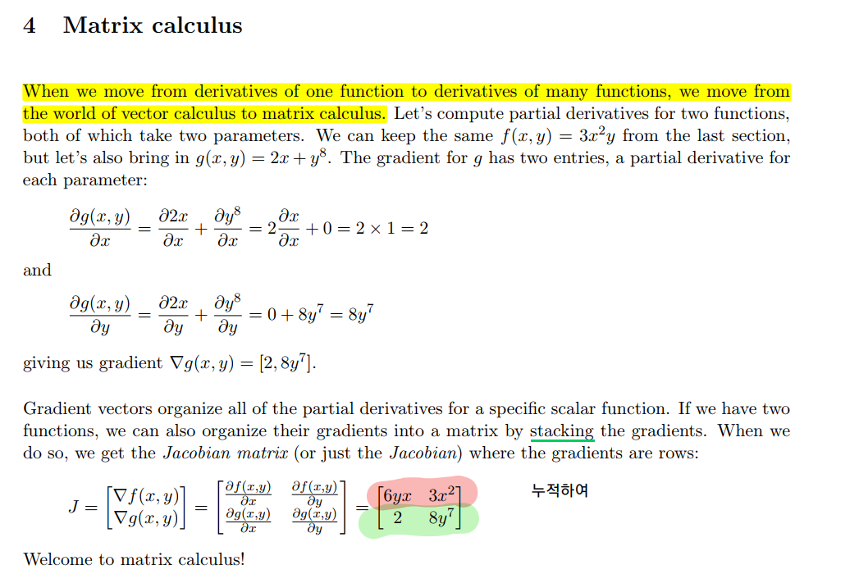
Gradients and Jacobians

Slide 3
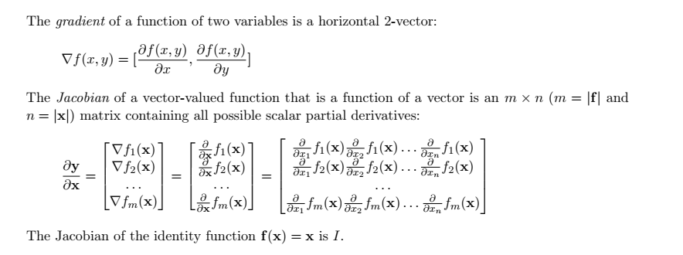
Gradients and Jacobians

Slide 4
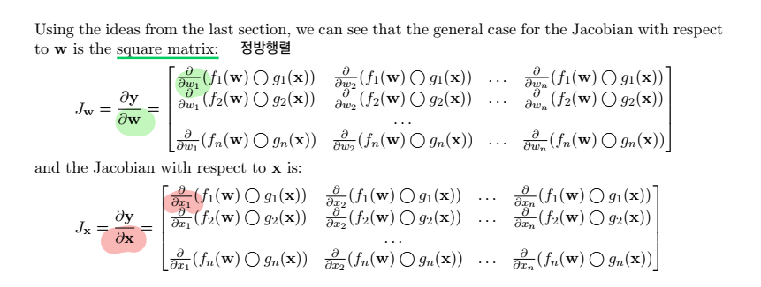
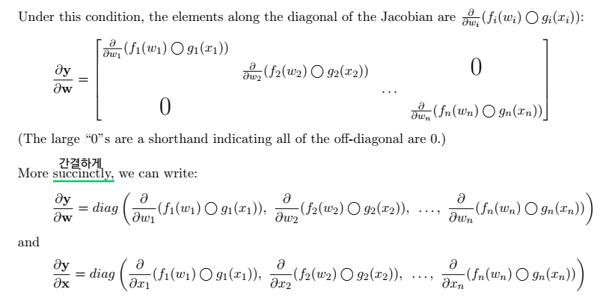
Element-wise operations on vectors
Notes:
Elemnet-wise 연산 : 같은 위치에 있는 값끼리 연산

Slide 5
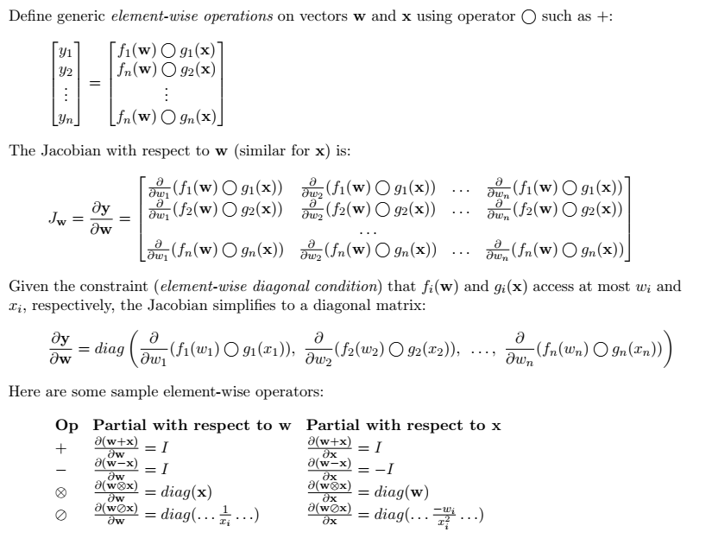
Element-wise operations on vectors
Notes:
Elemnet-wise 연산 : 같은 위치에 있는 값끼리 연산

Slide 6
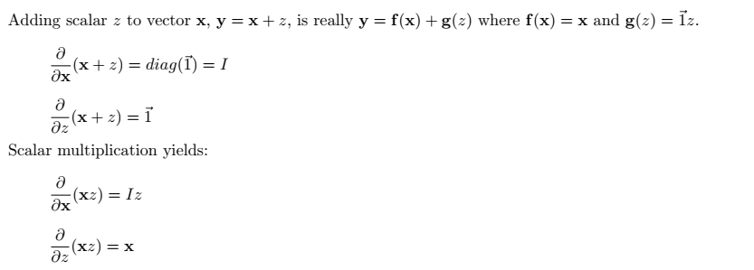
Scalar expansion

Slide 7
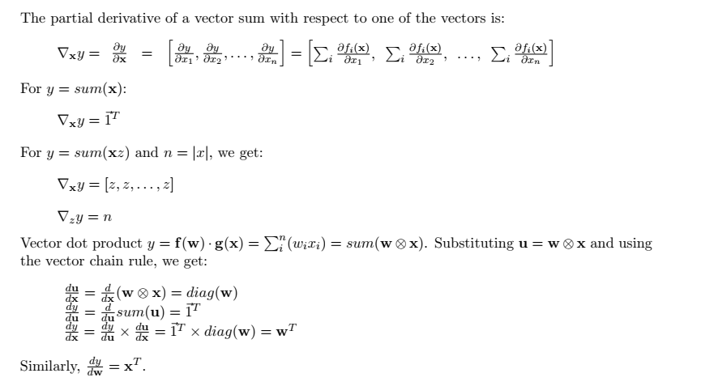
Vector reductions

Slide 8
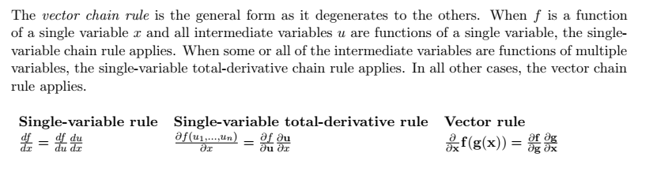
Chain rules

Slide 9
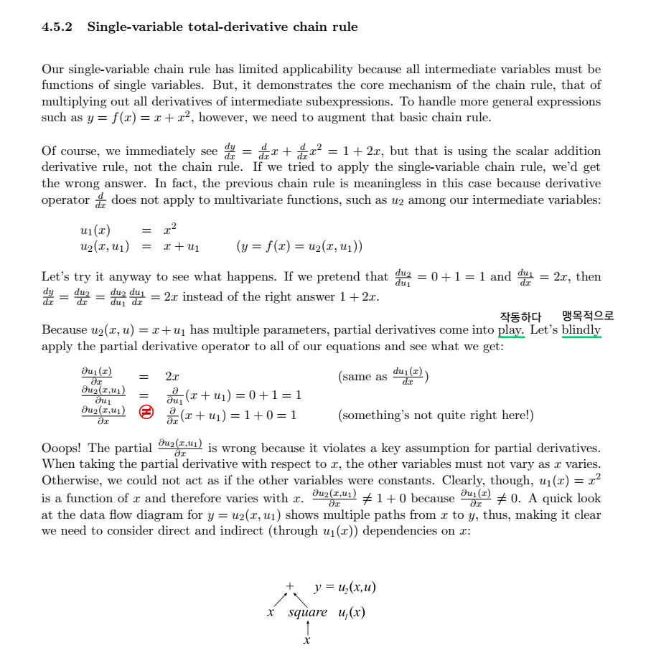
Chain rules

Slide 10
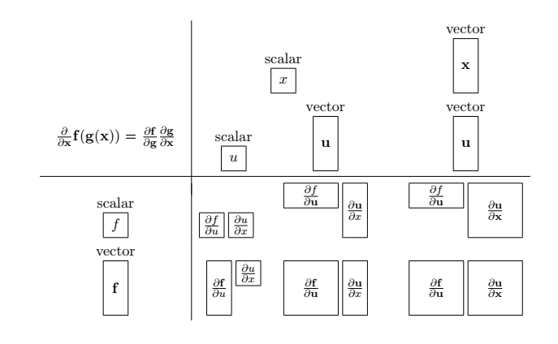
Element-wise operations on vectors
Notes:
Elemnet-wise 연산 : 같은 위치에 있는 값끼리 연산

Slide 11
Thanks
Do you have any questions?

Slide 12
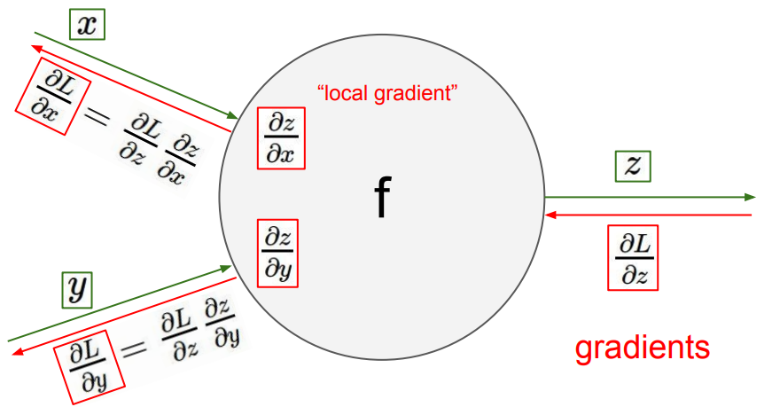
Element-wise operations on vectors
Notes:
Elemnet-wise 연산 : 같은 위치에 있는 값끼리 연산

